Slide 1
Physicians Research Institute
Gene Ransom, CEO, MedChi
AMA Annual Meeting
OSMAP
June 9, 2017

Slide 2
What Is the Physician Research Institute?
The Physicians Research Institute (PRI) is a not for profit group created by state medical societies to counter the biased “studies” of groups such as Workers’ Compensation Research Institute (WCRI), the National Council on Compensation Insurance (NCCI), the California Workers’ Compensation Institute (CWCI), and insurance companies such as Accident Fund Holdings (Accident Fund).
The founding medical societies saw these “studies” being used in legislative debates to promote efforts to restrict doctors from prescribing therapies or dispensing medicines as they saw fit. In this respect, workers’ compensation insurers were seeking to act like HMOs in the 1990s in limiting tests or restricting therapies deemed necessary by treating doctors. Moreover, these insurers were asking for and, in many cases receiving, legislative approval for such restrictions. In all such cases, the WCRI, CWCI, NCCI and Accident Fund “studies” formed the basis for actual or proposed legislative action.

Slide 3
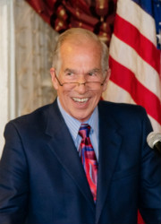
PRI LEADERSHIP
Jay Schwartz, founder of a prominent Maryland law firm, led the fight in Maryland to expose the WCRI studies. He was tasked to serve as PRI’s first President
Donald Palmisano, Medical Association of Georgia and I serve on the PRI Board.

Slide 4
Independent Analysis
PRI was formed by state medical societies, in part, to address the bias of insurance funded research studies being used to influence public policy throughout the United States.
PRI believes the best way to insure that it is not guilty of similar bias is to reference research and journalism by truly independent groups which reaches the same conclusions as PRI.

Slide 5
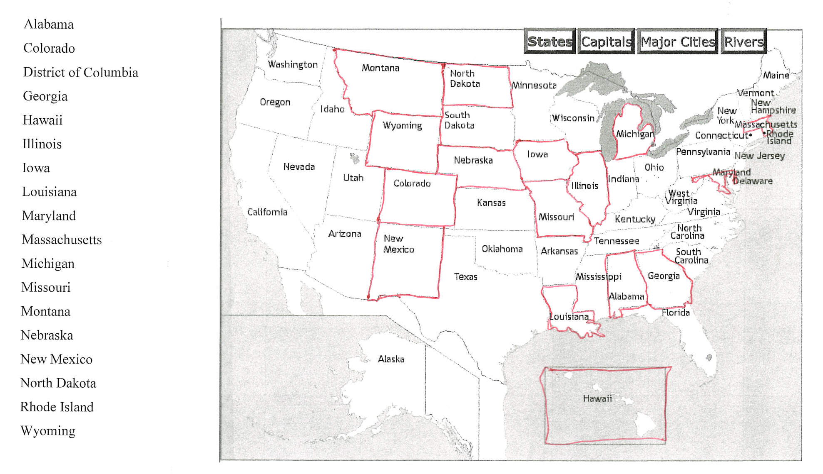
Current Medical Society Members of PRI

Slide 6
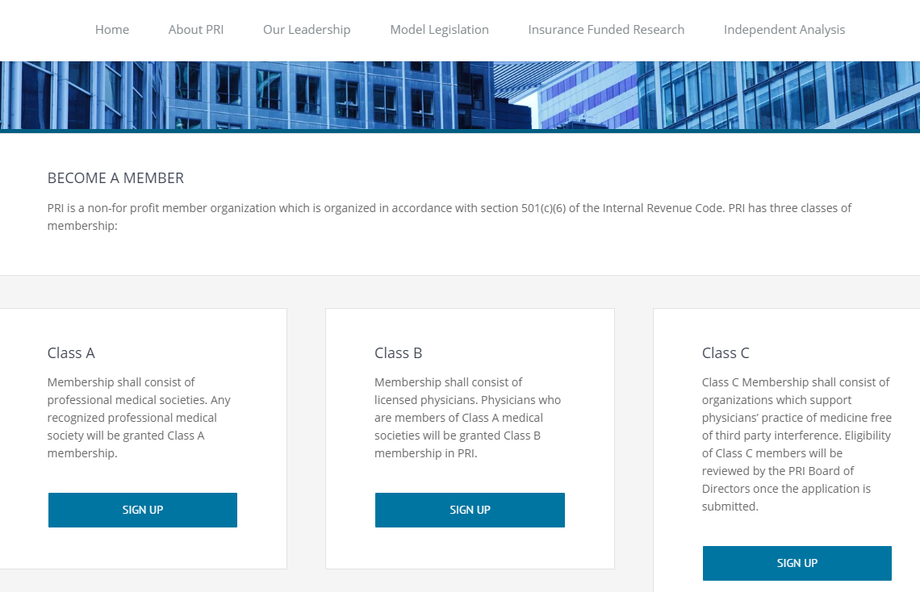
How to Join PRI
It’s free. Reach out to me if you have questions or concerns.
Join online or by email
Visit www.physiciansresearchinstitute.org
Email jay@prigroup.org.

Slide 7
Thank you for allowing me to present on PRI!

